Slide 1
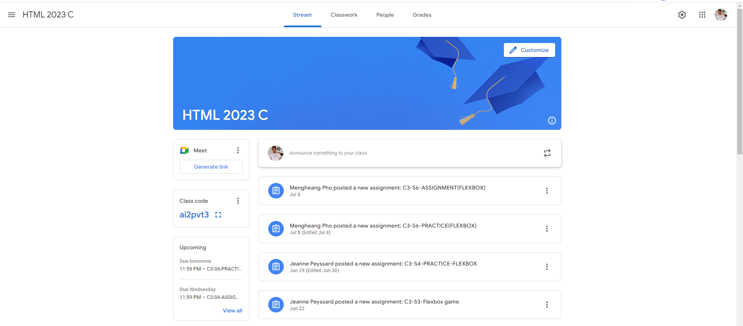
Identify root components of website below

Slide 2
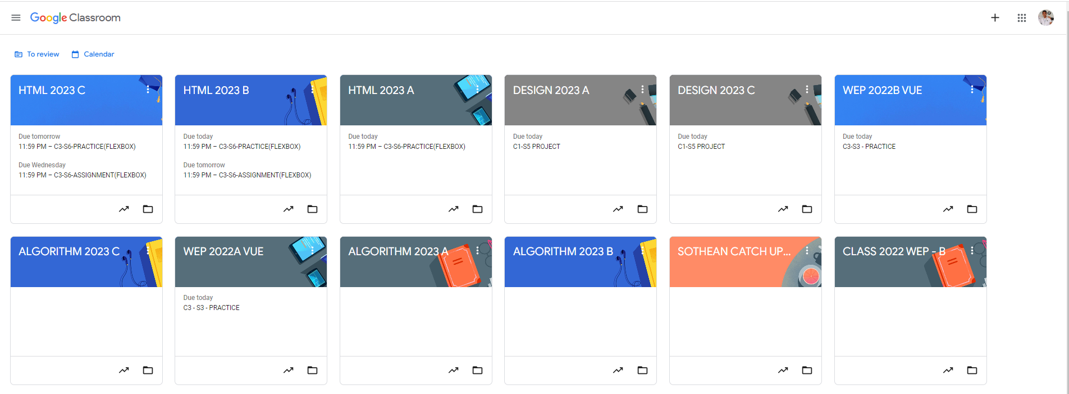
Root div
- Height: 100vh
content
nav
Flex: 0
header
Flex: 0
Flex: 1

Slide 3
navigation
Left nav
Mid nav
Right nav
header
Main
content
Section 1
section2

